Slide 1
Pizza Service
Dream team
SDU 2014

Slide 2
Project Description
We will try to make site of pizzeria “Aszhan”. In this site, people can see all products and short description for them. And also, people can serve pizza from Internet.
Our goals:
People can know our menu, dishes before coming
Serving pizza to home

Slide 3
Actors
Visitors: everyone who has connection to the Internet
System Administrator: Someone who controls the site

Slide 4
Use cases
Visitors:
View homepage
View about us
To see what catering services we have
Order pizza
To see gallery of photos about organization dishes
To know how to contact us
System Administrator
Manage order

Slide 5
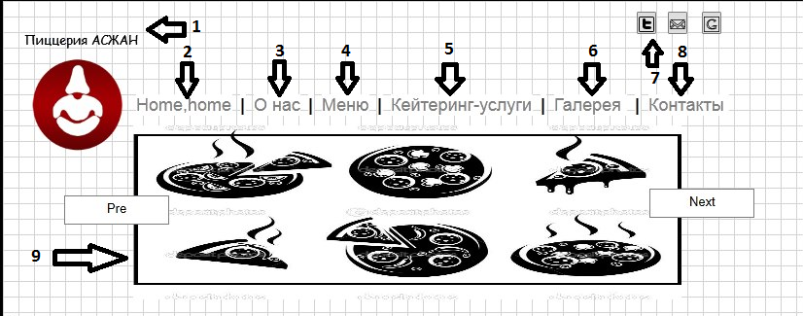
This is a half of our home page
Logo of organization
Home page
About the company
All the dishes that in the menu
Service, which provides food in organizations
6. Gallery
7. Publish in social networks such as
Twitter, vk, mail
8. Provides address and phones to contact with organization
9. Photo slider

Slide 6
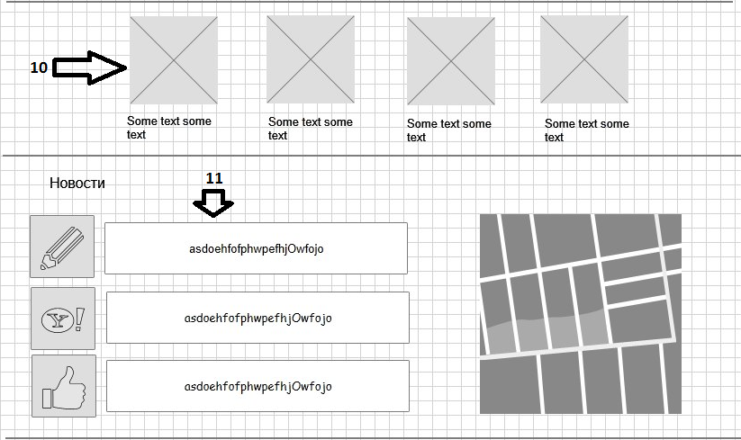
Second half of our home page
10. Special organization dishes
11. News about future events(celebrations) and new dishes

Slide 7
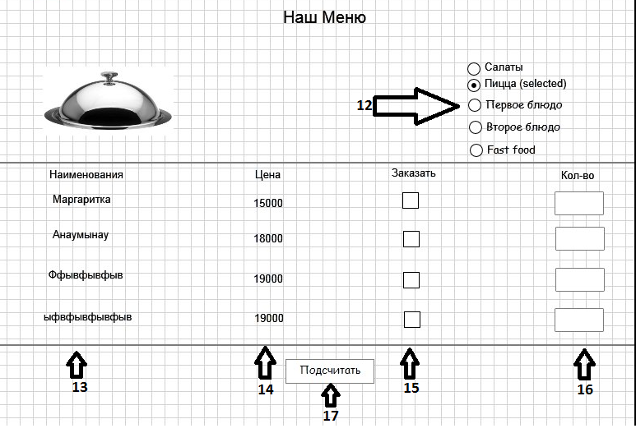
This is our menu page
12. Select the dish to serve
13. Name of dish
14. Price of each dish
15. Order or not
16. How many quantity to serve
17. To count all orders

